Slide 1


SQL- PROJECT
Mysql course- Besant Technologies
By-
Abhishek B K
8880445554
korishettyabhishek@gmail.com

Slide 2


SQL
Structured query language(SQL) is the programming language used to maintain and manipulate relational databases.
Relational databases are the databases which store data in the form of tables and follow the E.F Codd rules.
In these we analyze the IPL dataset with the help of SQL
The sample IPL dataset can be downloaded from the Kaggle website.

Slide 3
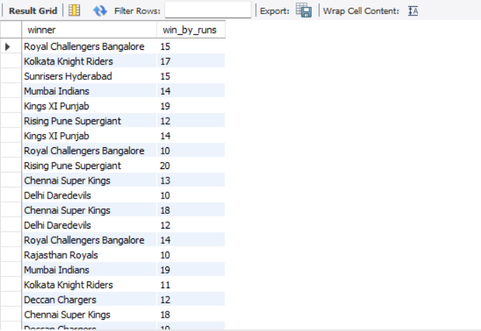
1. BETWEEN – Find matches won by a margin between 10 and 20 runs
SELECT winner, win_by_runs
FROM matches
WHERE win_by_runs BETWEEN 10 AND 20;

Slide 4
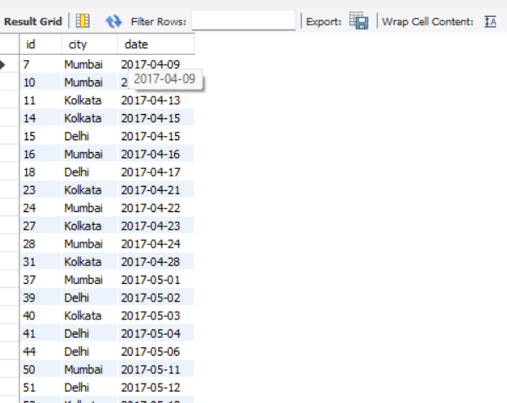
2. IN – Find matches played in select cities
SELECT id, city, date
FROM matches
WHERE city IN ('Mumbai', 'Delhi', 'Kolkata');

Slide 5
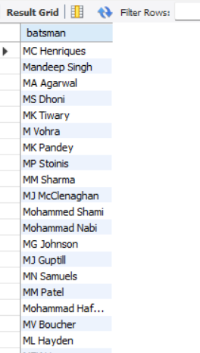
3. LIKE – Find players whose name starts with 'M'
SELECT DISTINCT batsman
FROM deliveries
WHERE batsman LIKE 'M%';

Slide 6
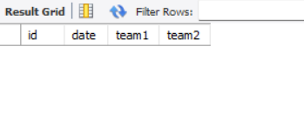
4. IS NULL – Find matches with missing city info
SELECT id, date, team1, team2
FROM matches
WHERE city IS NULL;

Slide 7
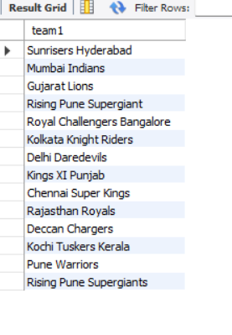
5. EXISTS – Find teams that have played at least one match
SELECT DISTINCT team1 FROM matches
WHERE EXISTS (SELECT DISTINCT team2 FROM matches);

Slide 8
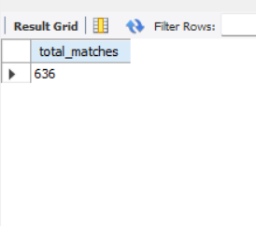
6. What is the total number of matches played?
SELECT COUNT(*) AS total_matches FROM matches;

Slide 9
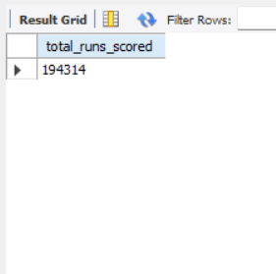
7.How many total runs were scored in IPL history?
SELECT SUM(total_runs) AS total_runs_scored FROM deliveries;

Slide 10
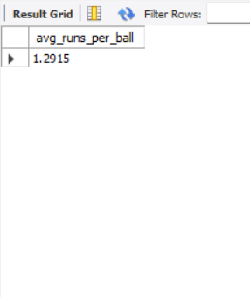
8. What is the average number of runs per ball?
SELECT AVG(total_runs) AS avg_runs_per_ball FROM deliveries;

Slide 11
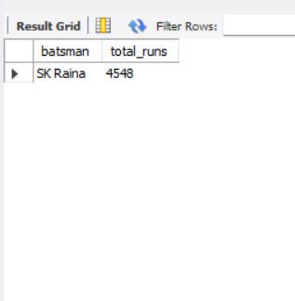
9. Who scored the maximum number of runs overall?
SELECT batsman, SUM(batsman_runs) AS total_runs
FROM deliveries
GROUP BY batsman
ORDER BY total_runs DESCLIMIT 1;

Slide 12
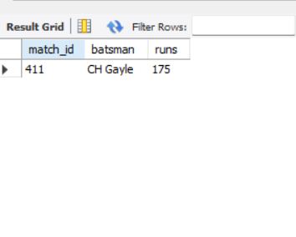
10. What is the highest individual score in a match by a batsman?
SELECT match_id, batsman, SUM(batsman_runs) AS runs
FROM deliveries
GROUP BY match_id, batsman
ORDER BY runs DESCLIMIT 1;

Slide 13
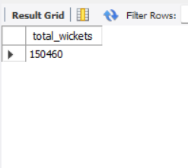
11. How many total wickets were taken?
SELECT COUNT(*) AS total_wickets
FROM deliveries
WHERE dismissal_kind IS NOT NULL;

Slide 14
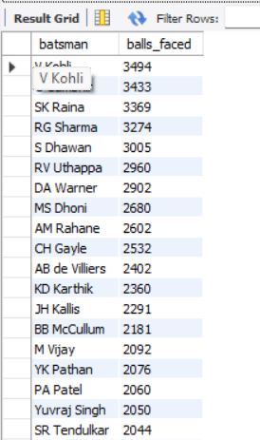
12. What is the average number of balls faced by batsmen?
SELECT batsman, COUNT(*) AS balls_faced
FROM deliveries
GROUP BY batsman
ORDER BY balls_faced DESC;

Slide 15

13. What is the highest win margin (by runs) in any match?
SELECT MAX(win_by_runs) AS max_win_margin FROM matches;

Slide 16
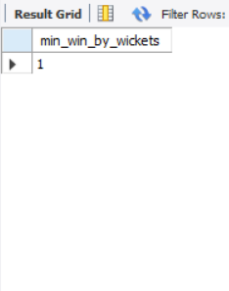
14. What is the smallest win margin (by wickets) in a match?
SELECT MIN(win_by_wickets) AS min_win_by_wickets
FROM matches
WHERE win_by_wickets > 0;

Slide 17
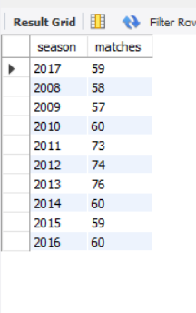
15. How many matches were played each season?
SELECT season, COUNT(*) AS matches
FROM matches
GROUP BY season;

Slide 18
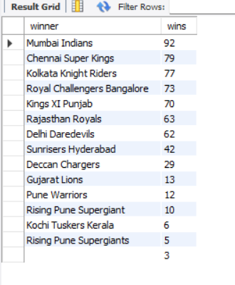
16. Who won the most matches?
SELECT winner, COUNT(*) AS wins
FROM matches
GROUP BY winner
ORDER BY wins DESC;

Slide 19
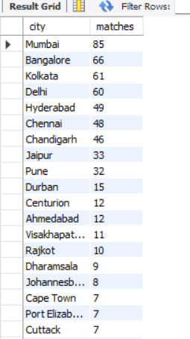
17. What is the average number of matches hosted per city?
SELECT city, COUNT(*) AS matches
FROM matches
GROUP BY city
ORDER BY matches DESC;

Slide 20
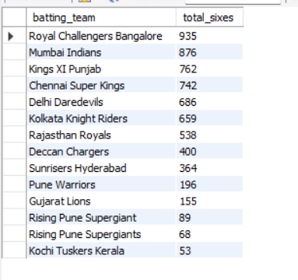
18. What is the total number of sixes hit by each team?
SELECT batting_team, COUNT(*) AS total_sixes
FROM deliveries
WHERE batsman_runs = 6
GROUP BY batting_team
ORDER BY total_sixes DESC;

Slide 21
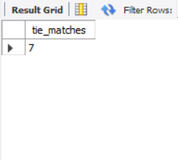
19. How many matches ended in a tie?
SELECT COUNT(*) AS tie_matches
FROM matches
WHERE result = 'tie';

Slide 22
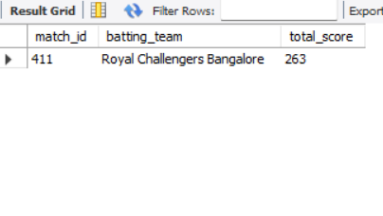
20. What is the highest total by a team in a single match?
SELECT match_id, batting_team, SUM(total_runs) AS total_score
FROM deliveries
GROUP BY match_id, batting_team
ORDER BY total_score DESC
LIMIT 1;

Slide 23
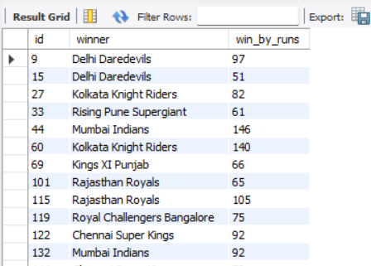
21. Find matches where the win margin by runs was greater than 50.
SELECT id, winner, win_by_runs
FROM matches
WHERE win_by_runs > 50;

Slide 24
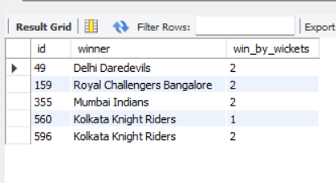
22. Find matches where the win margin by wickets was less than 3.
SELECT id, winner, win_by_wickets
FROM matches
WHERE win_by_wickets < 3 AND win_by_wickets > 0;

Slide 25
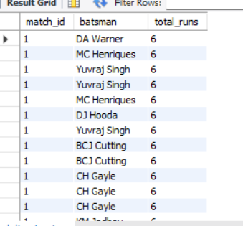
23. List all deliveries where more than 4 runs were scored.
SELECT match_id, batsman, total_runsFROM deliveriesWHERE total_runs > 4;

Slide 26
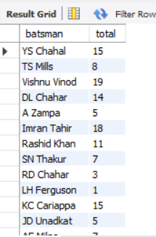
24. Which batsmen scored less than 20 total runs in the entire tournament?
SELECT batsman, SUM(batsman_runs) AS totalFROM deliveriesGROUP BY batsmanHAVING total < 20;

Slide 27
25. Which bowlers bowled more than 300 deliveries?
SELECT bowler, COUNT(*) AS balls_bowled
FROM deliveries
GROUP BY bowler
HAVING balls_bowled > 300;
SELECT bowler, COUNT(*) AS balls_bowled
FROM deliveries
GROUP BY bowler
HAVING balls_bowled > 300;

